Slide 1

Efficient Algorithms for Time Series REtrieval MSc Defense – Philipp Beer University of Nicosia
25.05.2022

Slide 2

Motivation
We present an algorithm suitable to be the foundation for a time-series search engine that identifies similar time series from of pool of time series data.
Time complexity should be adequate for search engine
Algorithm should be flexible to time series properties
Exact closest match is not required (rather good overall results)

Slide 3
Agenda
Key Concepts
Introduction DTW
Methodology
Encoding of time series pool
Matching time series
Challenges
Window Functions
Frequency Intervals
Data Pool - Analysis Overview
Demo / Results Overview
Discussion and Future Work

Slide 4
Key Concepts
Time Series Retrieval – Key Idea
Dimensionality Reduction
reduction in time complexity
Time Series Similarity Classifications
lock-step, elastic, threshold-based and pattern based measures
Time-rigid vs time-flexible measures
Feature-based methods

Slide 5
Key Concepts Euclidean Distance
Euclidean Distance
Most widely-used similarity metric
Easy to compute
Intuitive to understand
Not flexible with different length time series
Does not manage outliers, noise
Linear time complexity
Limited in application in real-world scenarios

Slide 6
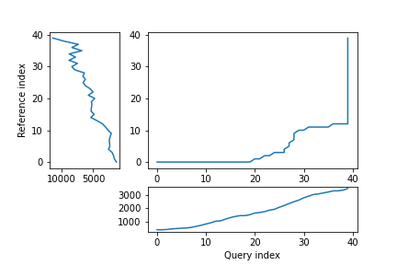
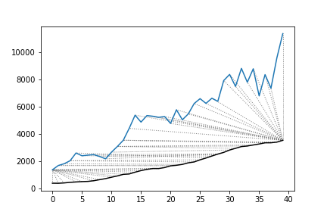
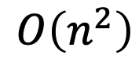
Key Concepts Dynamic Time Warping (DTW)
Cost Matrix
TS 2
TS 1
DTW
Used for comparison to our FFT approach
Most used time series similarity measure
Minimal total-path through 2 time series (warping) with exhaustive search
Outliers can lead to clustering
Not scalable (time complexity)
TS 2
TS 1
$$O\left(n^{2}\right)$$
Time Complexity:
Notes:
Dynamic Time Warping
Introduced in 1994 by Berndt and Clifford
Minimized alignment between two time series via cost-matrix and identifying the minimal total path through that time series (warping)
Exhaustive search across two time series
Times series can be of different length
Much more in depth in comparison to simple ED (finds the smallest possible cumulative results)
Outliers can lead to clustering (see image)
Biggest draw-back: time complexity -> non-linear relationship
Not useable against a large array of time series (therefore applicable as algorithm for a search engine)

Slide 7
Key Concepts Dynamic Time Warping (DTW)
Cost Matrix
S_{i-2 j} | S_{i-1 j} | S_{i j}
S_{i-2 j-1} | S_{i-1 j-1} | S_{i j-1}
S_{i-2 j-2} | S_{i-1 j-2} | S_{i j-2}
TS 2
TS 1
DTW
Used for comparison to our FFT approach
Most used time series similarity measure
Minimal total-path through 2 time series (warping) with exhaustive search
Outliers can lead to clustering
Not scalable (time complexity)
TS 2
TS 1
$$O\left(n^{2}\right)$$
Time Complexity:
Notes:
Dynamic Time Warping
Introduced in 1994 by Berndt and Clifford
Minimized alignment between two time series via cost-matrix and identifying the minimal total path through that time series (warping)
Exhaustive search across two time series
Times series can be of different length
Much more in depth in comparison to simple ED (finds the smallest possible cumulative results)
Outliers can lead to clustering (see image)
Biggest draw-back: time complexity -> non-linear relationship
Not useable against a large array of time series (therefore applicable as algorithm for a search engine)

Slide 8
Cost Matrix
D_{i-2 j} | D_{i-1 j} | D_{i j}
D_{i-2 j-1} | D_{i-1 j-1} | D_{i j-1}
D_{i-2 j-2} | D_{i-1 j-2} | D_{i j-2}
TS 2
$$γ\left(i,j\right)=D\left(s_{i},q_{j}\right)+min\left\{γ\left(i−1,j−1\right),γ\left(i−1,j\right),γ(i,j−1)\right\}$$
TS 1
TS 2
TS 1
Notes:
Dynamic Time Warping
Introduced in 1994 by Berndt and Clifford
Minimized alignment between two time series via cost-matrix and identifying the minimal total path through that time series (warping)
Exhaustive search across two time series
Times series can be of different length
Much more in depth in comparison to simple ED (finds the smallest possible cumulative results)
Outliers can lead to clustering (see image)
Biggest draw-back: time complexity -> non-linear relationship
Not useable against a large array of time series (therefore applicable as algorithm for a search engine)

Slide 9
Cost Matrix
D_{i-2 j} | D_{i-1 j} | D_{i j}
D_{i-2 j-1} | D_{i-1 j-1} | D_{i j-1}
D_{i-2 j-2} | D_{i-1 j-2} | D_{i j-2}
TS 2 (j)
TS 1 (i)
TS 2
TS 1
Notes:
Dynamic Time Warping
Introduced in 1994 by Berndt and Clifford
Minimized alignment between two time series via cost-matrix and identifying the minimal total path through that time series (warping)
Exhaustive search across two time series
Times series can be of different length
Much more in depth in comparison to simple ED (finds the smallest possible cumulative results)
Outliers can lead to clustering (see image)
Biggest draw-back: time complexity -> non-linear relationship
Not useable against a large array of time series (therefore applicable as algorithm for a search engine)

Slide 10
Cost Matrix
D_{i-2 j} | D_{i-1 j} | D_{i j}
D_{i-2 j-1} | D_{i-1 j-1} | D_{i j-1}
D_{i-2 j-2} | D_{i-1 j-2} | D_{i j-2}
TS 2
TS 1
TS 2
TS 1
Notes:
Dynamic Time Warping
Introduced in 1994 by Berndt and Clifford
Minimized alignment between two time series via cost-matrix and identifying the minimal total path through that time series (warping)
Exhaustive search across two time series
Times series can be of different length
Much more in depth in comparison to simple ED (finds the smallest possible cumulative results)
Outliers can lead to clustering (see image)
Biggest draw-back: time complexity -> non-linear relationship
Not useable against a large array of time series (therefore applicable as algorithm for a search engine)

Slide 11
Key Concepts Fast FOUrier Transform
Fourier Analysis
Principal idea: project functions and data vectors into a coordinate system of sine and cosine
Fast Fourier Transform reduces computational complexity
Parseval’s Theorem
Power Spectral Density – magnitude of frequencies described
Key Idea: Use PSD-ranked frequencies to describe similarity between time series
Notes:
PSD measure for signal strength

Slide 12
Methodology

Slide 13
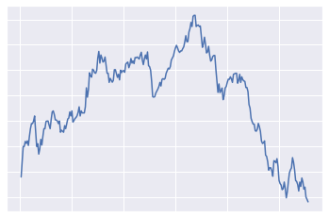
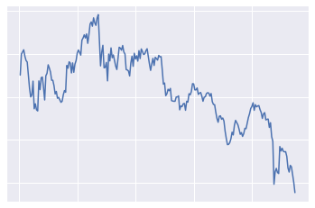
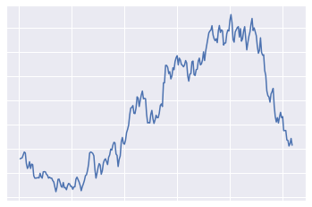
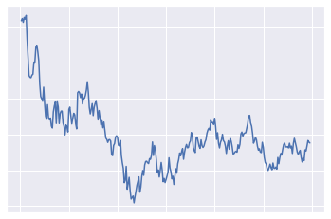
Raw
Time Series

Slide 14
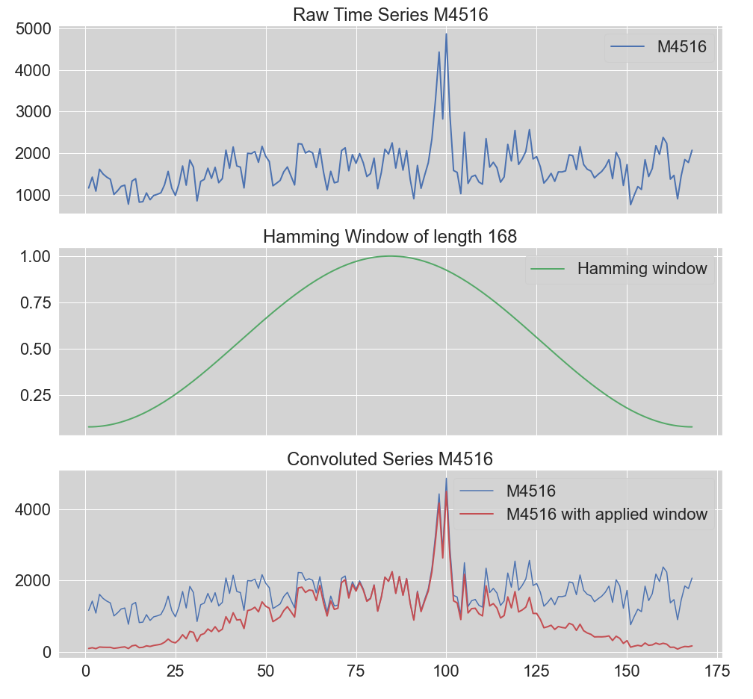
Window Functions
Normal Time Series + Window = Convoluted Series
Notes:
To address spectral leakage via tapering

Slide 15
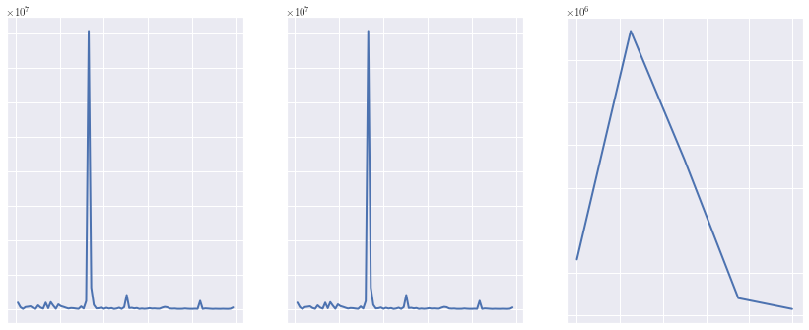
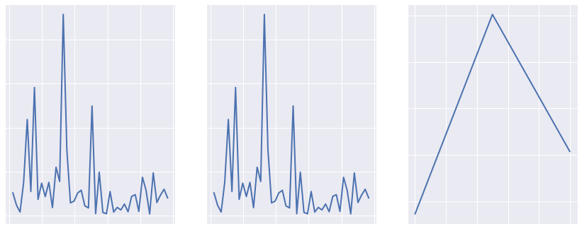
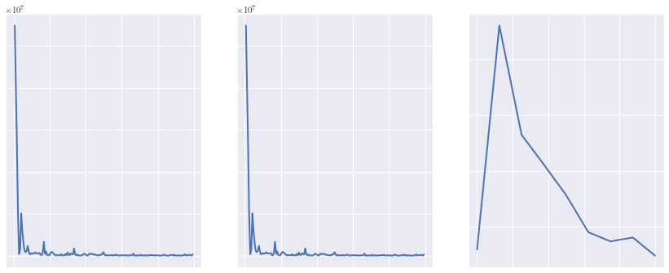
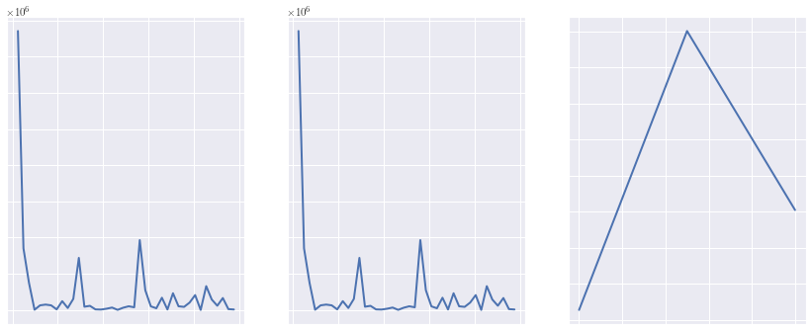
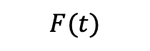



Raw
Time Series
Transform to Frequency Domain
Standard FFT
FFT with
Hamming
FFT with
Welch
$$F(t)$$
$$F(t)$$
$$F(t)$$
$$F(t)$$
$$1$$

Slide 16
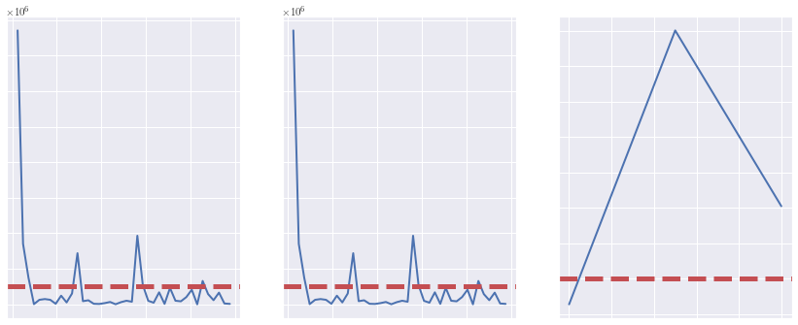

Raw
Time Series
Transform to Frequency Domain
Identify Top 5 Frequencies
Standard FFT
FFT with
Hamming
FFT with
Welch
$$F(t)$$
$$F(t)$$
$$F(t)$$
$$F(t)$$
$$1$$
$$2$$

Slide 17
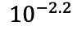
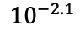

Raw
Time Series
Transform to Frequency Domain
Identify Top 5 Frequencies
Compute Top 5
Frequency Intervals
Standard FFT
FFT with
Hamming
FFT with
Welch
$$F(t)$$
$$F(t)$$
$$F(t)$$
$${10}^{−2.1}$$
$${10}^{−2.2}$$
$${10}^{−2.1}$$
$${10}^{−2.2}$$
$$F(t)$$
$$1$$
$$2$$
$$3$$

Slide 18
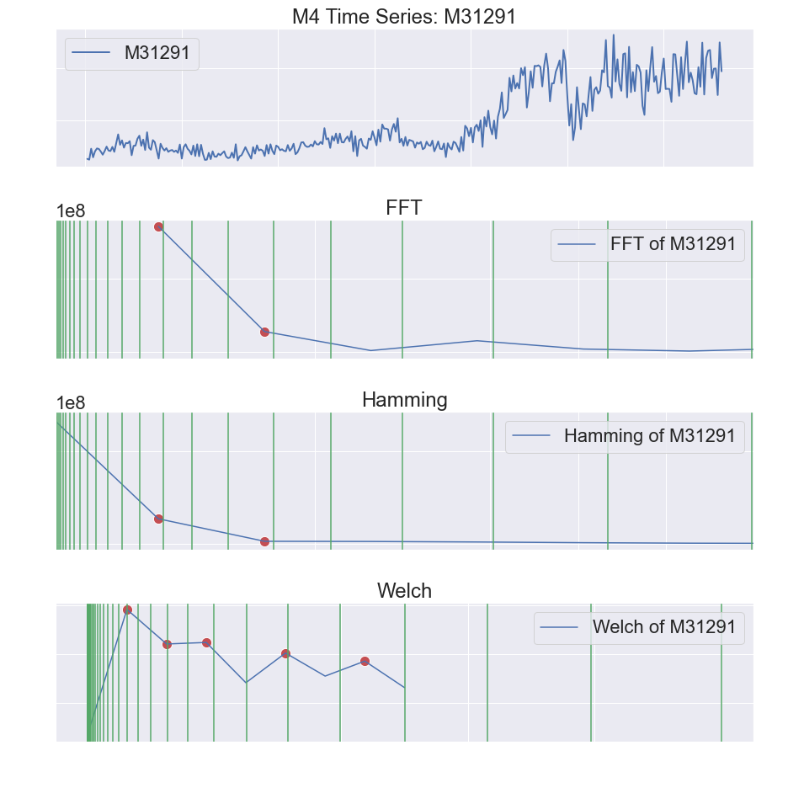
Example Frequency Ranges

Slide 19
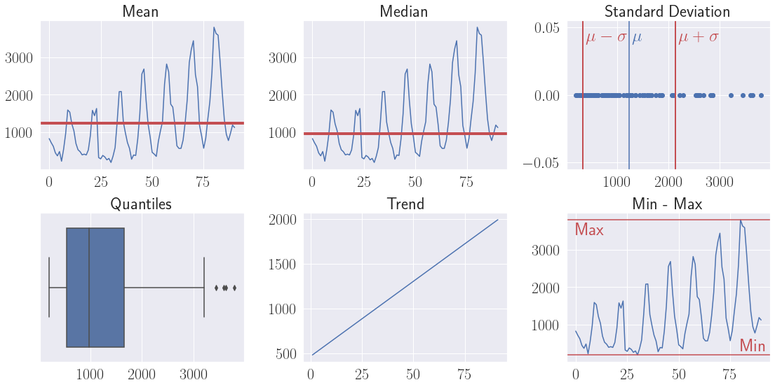


Raw
Time Series
Compute Summary Statistics for each Time Series
$$Stats$$
$$Stats$$
$$Stats$$

Slide 20
MATCHING Time SEries

Slide 21
Template
Time Series

Slide 22
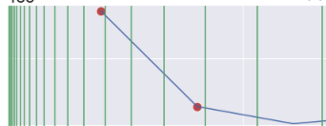
Template
Time Series
Identify top K
frequencies
Transform to Frequency Range
FFTs
$${10}^{−2.1}$$
$${10}^{−2.2}$$
$$F(t)$$

Slide 23
Template
Time Series
Identify top K
frequencies
Transform to Frequency Domain
FFTs
$${10}^{−2.1}$$
$${10}^{−2.2}$$
$$F(t)$$
Compute Summary Statistics
$$Stats$$

Slide 24
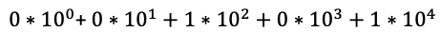
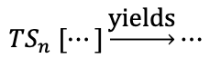
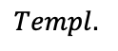
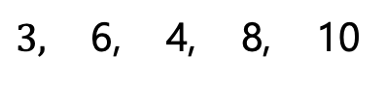
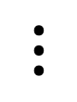
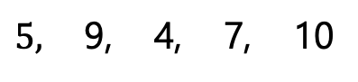
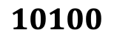
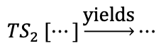
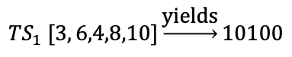

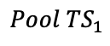
Template
Time Series
Identify top K
frequencies
Transform to Frequency Domain
Compute Match Score
$$Templ.$$
$5,$ 9, 4, 7, 10
$${TS}_{1} [3, 6,4,8,10]\underset{→}{\text{yields}}10100$$
$${TS}_{2} [⋯]\underset{→}{\text{yields}}⋯$$
FFTs
$$Pool {TS}_{1}$$
$3,$ 6, 4, 8, 10
$$⋮$$
$0∗{10}^{0}$+ $0∗{10}^{1}+1∗{10}^{2}+0∗{10}^{3}+1∗{10}^{4}$
$$=$$
$$10100$$
$${TS}_{n} [⋯]\underset{→}{\text{yields}}⋯$$
$${10}^{−2.1}$$
$${10}^{−2.2}$$
$$F(t)$$
Compute Summary Statistics
$$Stats$$

Slide 25
Template
Time Series
Identify top K
frequencies
Transform to Frequency Domain
Compute Match Score
$$Templ.$$
$5,$ 9, 4, 7, 10
$${TS}_{1} [3, 6,4,8,10]\underset{→}{\text{yields}}10100$$
$${TS}_{2} [⋯]\underset{→}{\text{yields}}⋯$$
FFTs
$$Pool {TS}_{1}$$
$3,$ 6, 4, 8, 10
$$⋮$$
$0∗{10}^{0}$+ $0∗{10}^{1}+1∗{10}^{2}+0∗{10}^{3}+1∗{10}^{4}$
$$=$$
$$10100$$
$${TS}_{n} [⋯]\underset{→}{\text{yields}}⋯$$
$${10}^{−2.1}$$
$${10}^{−2.2}$$
Highest Matches per Type
 | FFT | Hamming | Welch
Best Match | 11010 | 10100 | 11011
$$F(t)$$
Compute Summary Statistics
$$Stats$$

Slide 26
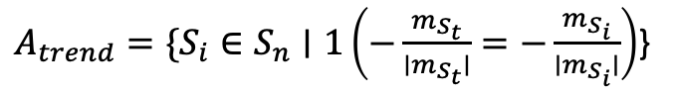
Template
Time Series
Identify top K
frequencies
Transform to Frequency Domain
Compute Match Score
$$Templ.$$
$5,$ 9, 4, 7, 10
$${TS}_{1} [3, 6,4,8,10]\underset{→}{\text{yields}}10100$$
$${TS}_{2} [⋯]\underset{→}{\text{yields}}⋯$$
FFTs
$$Pool {TS}_{1}$$
$3,$ 6, 4, 8, 10
$$⋮$$
$0∗{10}^{0}$+ $0∗{10}^{1}+1∗{10}^{2}+0∗{10}^{3}+1∗{10}^{4}$
$$=$$
$$10100$$
$${TS}_{n} [⋯]\underset{→}{\text{yields}}⋯$$
$${10}^{−2.1}$$
$${10}^{−2.2}$$
Highest Matches per Type
 | FFT | Hamming | Welch
Best Match | 11010 | 10100 | 11011
$$F(t)$$
Compute Summary Statistics
$$Stats$$
Match Slope Direction
$A_{trend}=\{S_{i}∈S_{n}∣1\left(−\frac{m_{S_{t}}}{∣m_{S_{t}}∣}=−\frac{m_{S_{i}}}{∣m_{S_{i}}∣}\right)$}
Miminize Statistical Metric

Slide 27

Template
Time Series
Identify top K
frequencies
Transform to Frequency Domain
Compute Match Score
$$Templ.$$
$5,$ 9, 4, 7, 10
$${TS}_{1} [3, 6,4,8,10]\underset{→}{\text{yields}}10100$$
$${TS}_{2} [⋯]\underset{→}{\text{yields}}⋯$$
FFTs
$$Pool {TS}_{1}$$
$3,$ 6, 4, 8, 10
$$⋮$$
$0∗{10}^{0}$+ $0∗{10}^{1}+1∗{10}^{2}+0∗{10}^{3}+1∗{10}^{4}$
$$=$$
$$10100$$
$${TS}_{n} [⋯]\underset{→}{\text{yields}}⋯$$
$${10}^{−2.1}$$
$${10}^{−2.2}$$
Highest Matches per Type
 | FFT | Hamming | Welch
Best Match | 11010 | 10100 | 11011
$$F(t)$$
Compute Summary Statistics
$$Stats$$
Match Slope Direction
$A_{trend}=\{S_{i}∈S_{n}∣1\left(−\frac{m_{S_{t}}}{∣m_{S_{t}}∣}=−\frac{m_{S_{i}}}{∣m_{S_{i}}∣}\right)$}
Miminize Statistical Metric
$$\arg{\min{f\left(S_{i}\right)≔|φ_{S_{t}}−φ_{S_{i}}|}}$$

Slide 28
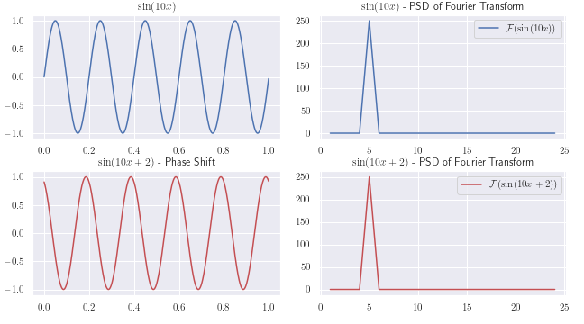
Challenges of fast fourier Transform
Phase Shift
Notes:
Spectral leakage – finite data points (if signal is not integer multiple of frequencies it LEAKS into adjacent frequencies

Slide 29
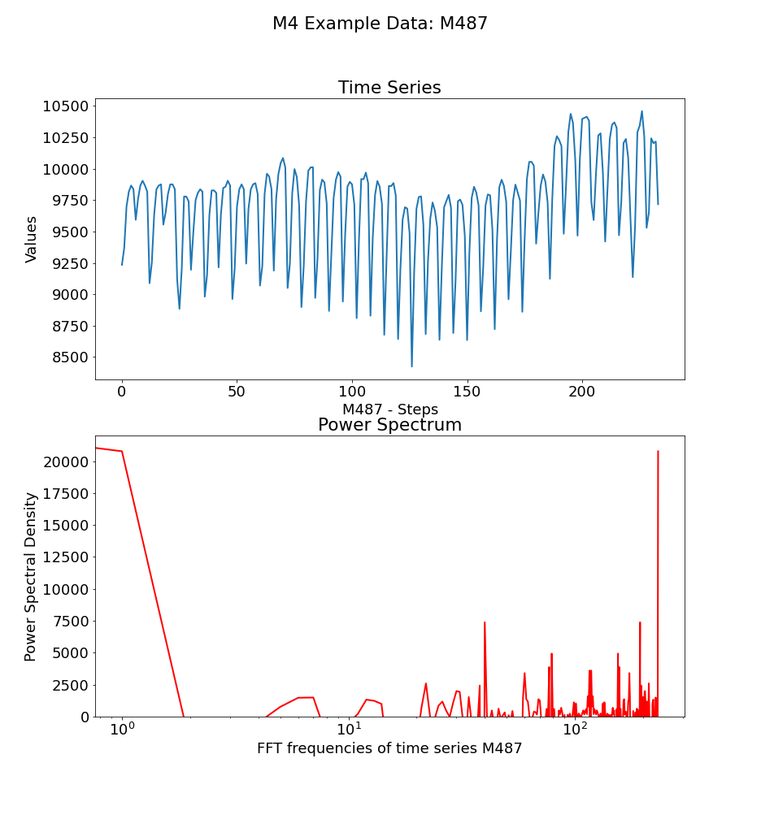
Challenges of fast fourier Transform
Spectral Leakage
Notes:
Spectral leakage – finite data points (if signal is not integer multiple of frequencies it LEAKS into adjacent frequencies

Slide 30
Window Functions
Hamming
Notes:
To address spectral leakage via tapering

Slide 31
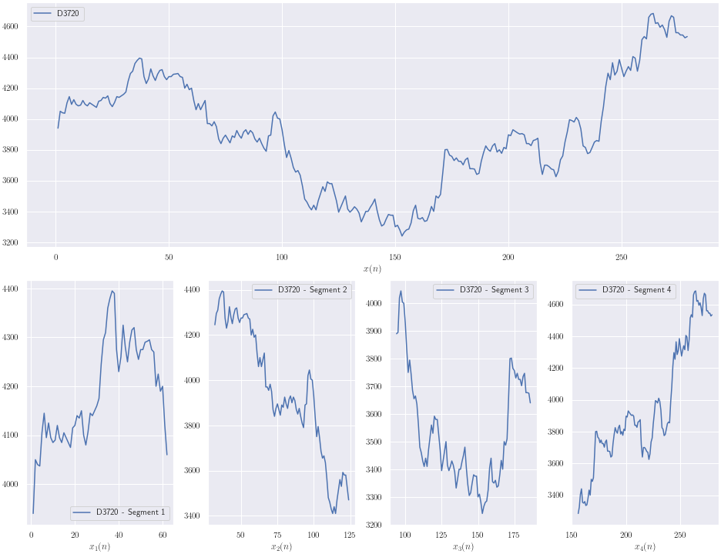
Window Functions
Welch’s Method
Notes:
To address spectral leakage via tapering

Slide 32
Frequency Intervals
Frequency Intervals
Notes:
Frequencies together with PSD provide information about the contribution of a individual signal
Original idea to avoid distance calculations between frequencies for measure closeness (however may not have gained to much)
Goal to describe approximation of the series with ordinal/categorical data to allow for simple is equal comparison (to save compute time)

Slide 33
Data Pool Analysis Overview

Slide 34
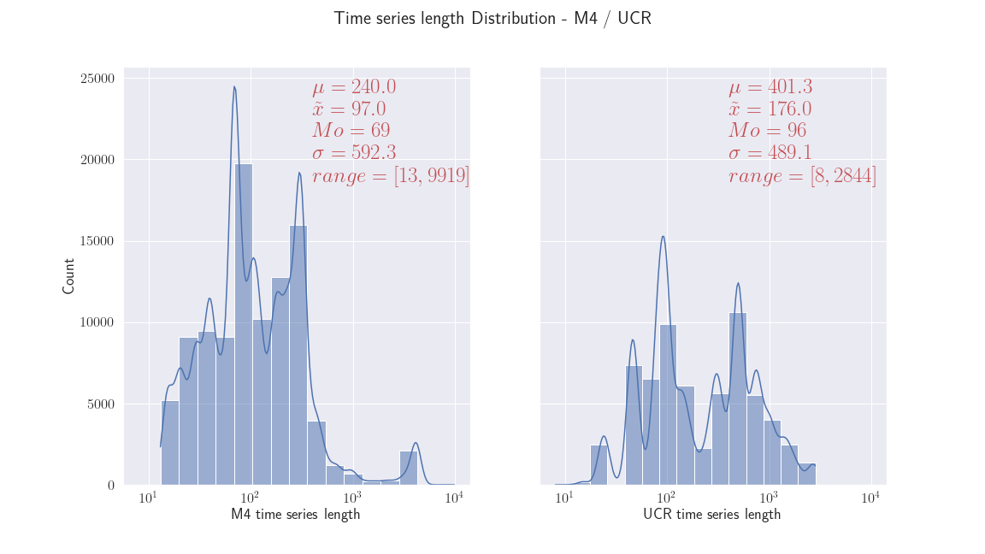
M4
UCR

Slide 35
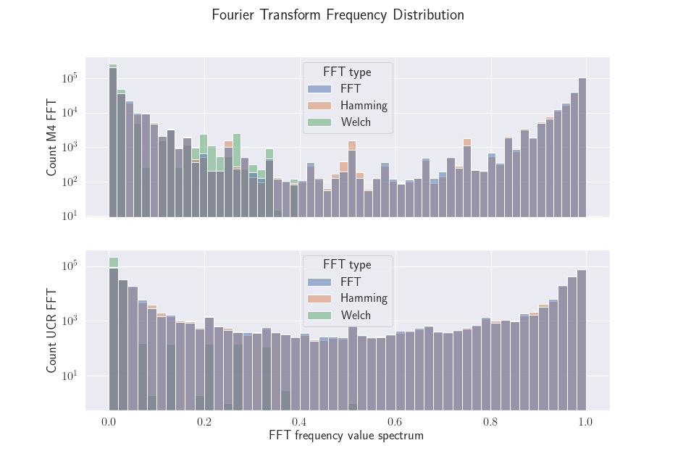
M4
UCR

Slide 36
Demo

Slide 37
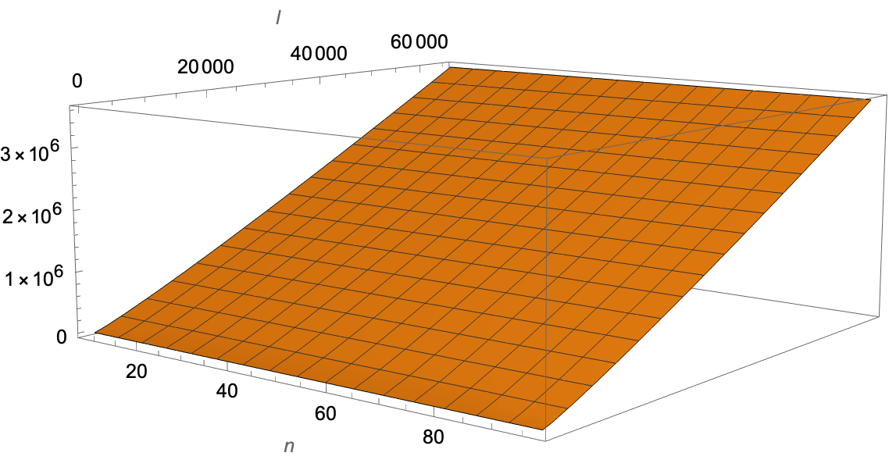
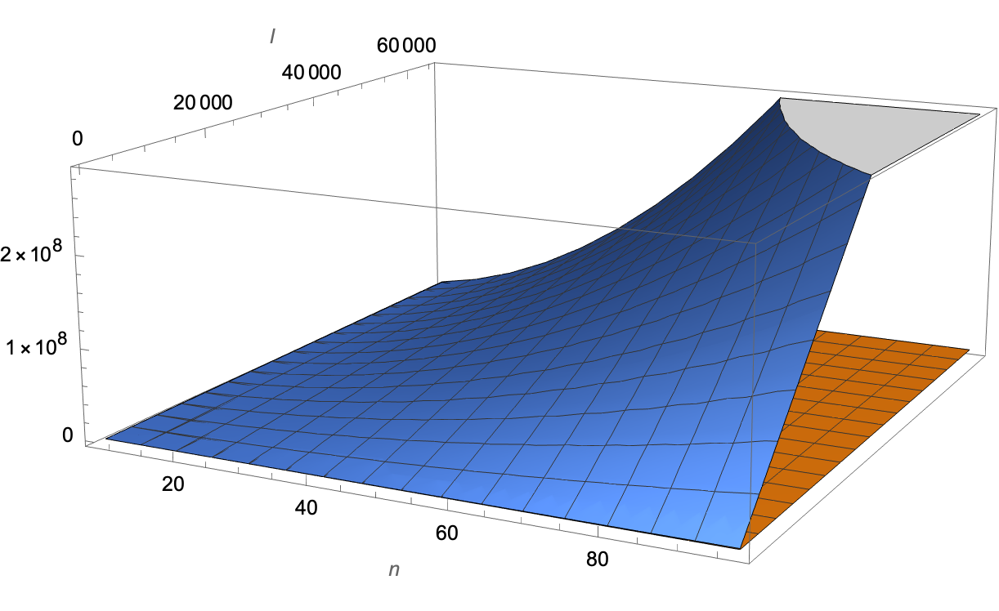

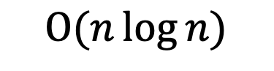
Computational Complexity – TS Search AlgorithM
$$Ο(n\log{n)}$$
$$Ο(ln^{2})$$
l = no. of series in pool
n = no. of time steps
y = no. of computations / time complexity

Slide 38
Results Overview

Slide 39
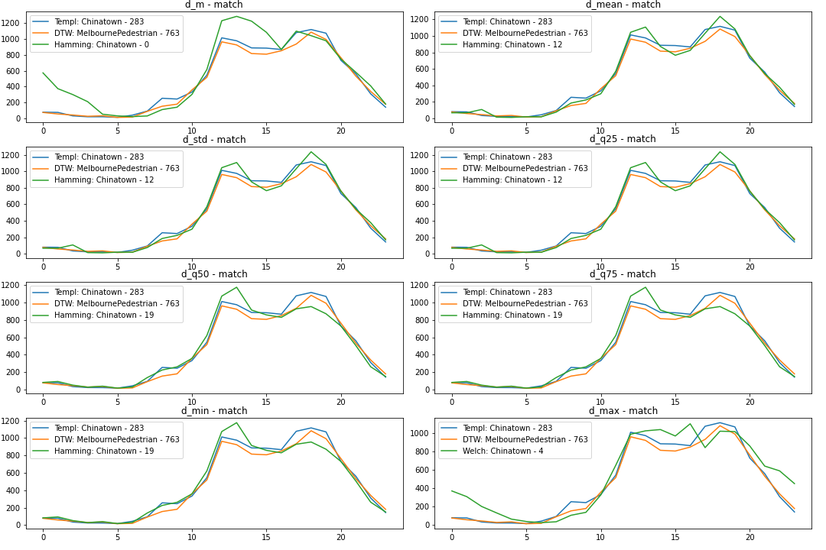
Results Overview

Slide 40
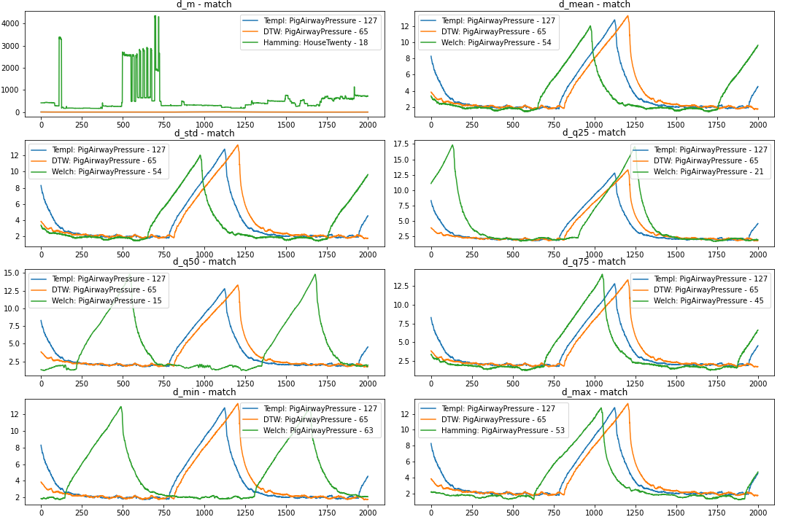
Results Overview
Matches with similar “similarity” compared to DTW
At a fraction of the computational cost

Slide 41
Results Overview
Phase shift can negatively impact the results if it is not controlled for (if summary statistics are not chosen wisely)

Slide 42
Results Overview
windows and summary statistics must be considered and chosen well for search OR manual analysis is required
Notes:
Windows

Slide 43
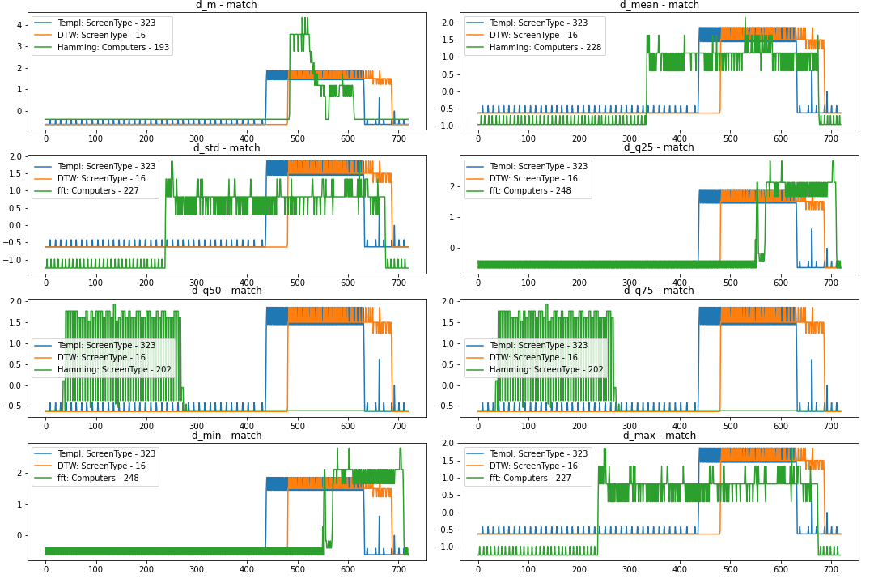
Results Overview
Mixed results with some patterns are found
Notes:
Mixed results can also be found
Some parts of the pattner (the higher frequency elements are identified) but the lower frequencies not well

Slide 44
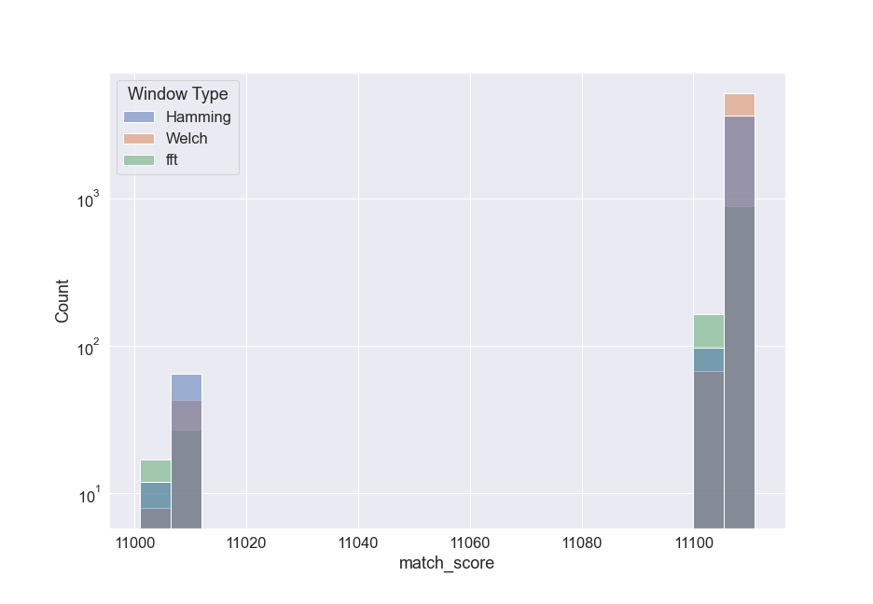
Results Overview
Match score count by window type
Match score indicate that windows are beneficial to time search search algorithm (Welch’s Method) to combat errors through spectral leakage
Notes:
Welch’s method has the best results
But all windows have side effects and need to be chosen well
Choose different window types to address the topic

Slide 45
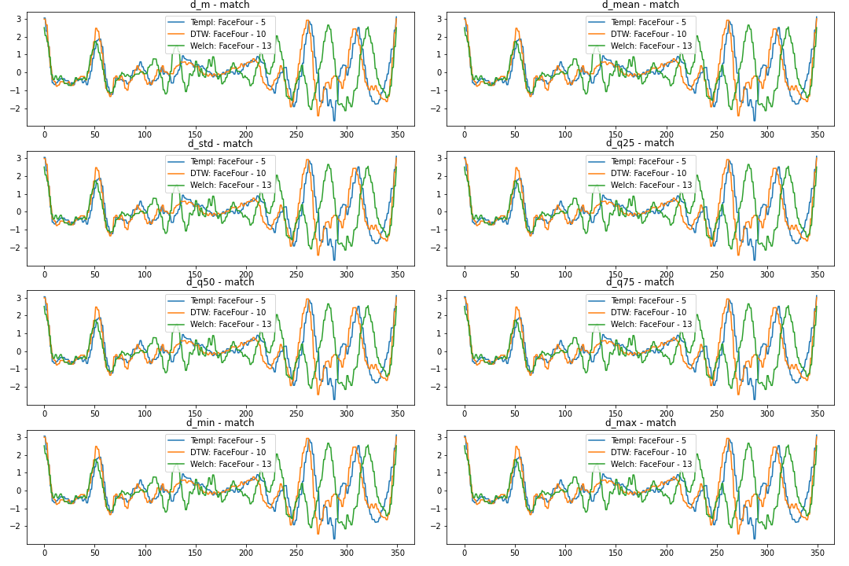
Discussion and Future Work
FFT together with window functions and summary statistics is powerful fast tool that leads to good results
Scale-invariant
Frequency-domain devoid of temporal information
No single metric in time series search algorithm serves as silver bullet
Notes:
FFT together with windows and summary statistics are a great foundation for ts search algo
Great run
- Try distance measure for frequencies to see if computation time increase significantly and whether accuracy goes up

Slide 46
Discussion and Future Work
Notes:
Try distance measure for frequencies to see if computation time increase significantly and whether accuracy goes up
Handle right side of frequencies with ranges that are built from the opposite and find matching score for both intervals

Slide 47
Thank You!
What questions do you have?

